Slide 1

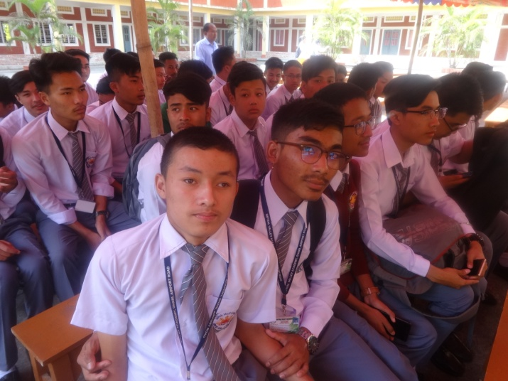




IMPHAL VALLEY ACADEMY

